Slide 1


Windows 13
Language:
English
Setup
Ready to Setup......
© 20▓▓ Microsoft Corporation

Slide 2
☢ WARNING：
You are about to install an operating system that does not exist! Do you want to continue anyway?
Continue
© 20▓▓ Microsoft Corporation

Slide 3

is installing, please wait......
Windows 13
© 20▓▓ Microsoft Corporation

Slide 6

Administrator

Slide 7
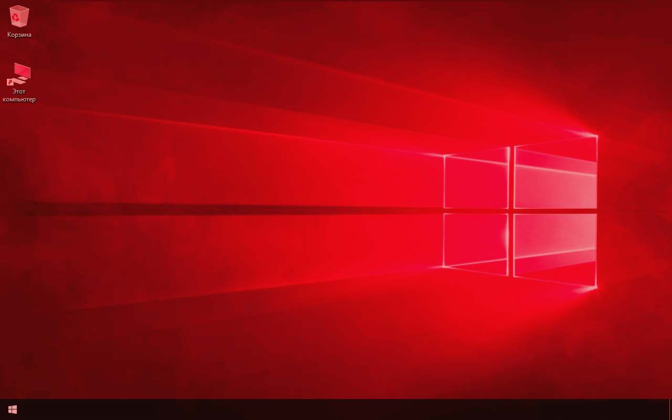

Slide 8

Return

Slide 9
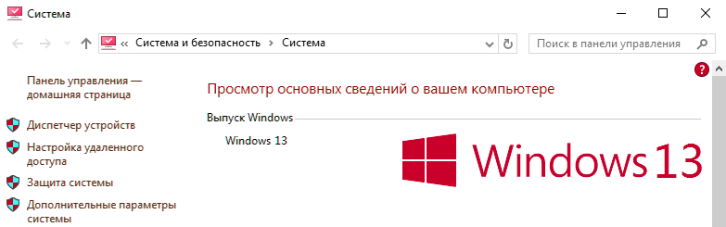

Slide 10

DON'T LOOK BEHIND YOU
I'M WATCHING YOU
Return

